Slide 1
Telecom Egypt Intelligent Assistant RAG-Powered Chatbot System
Prepared by: Mohamed Mostafa

Slide 2
Problem Statement
Telecom Egypt receives thousands of customer inquiries daily regarding: - Mobile & Internet plans - Billing & payments - Technical support
Challenges: - High volume of repetitive questions - Multilingual queries (Arabic, English, Egyptian dialect) - Need for accurate and fast responses

Slide 3
Proposed Solution
Develop an AI-powered chatbot using RAG (Retrieval-Augmented Generation) that: - Answers questions using official Telecom Egypt website
- Supports Arabic, English, and Egyptian dialect
- Allows document uploads for querying
- Provides accurate answers with sources

Slide 4
What is RAG?
Retrieval-Augmented Generation (RAG) is a technique that: 1. Retrieves relevant information from a knowledge base
2. Uses an LLM to generate answers based on that information
Benefits: - Reduces hallucinations - Ensures accurate answers - Provides source-based responses

Slide 5
RAG Architecture
User → Chat Interface → Backend (RAG System) → LLM
Steps: 1. User sends query 2. System retrieves relevant documents 3. LLM generates answer 4. Response returned with sources

Slide 6
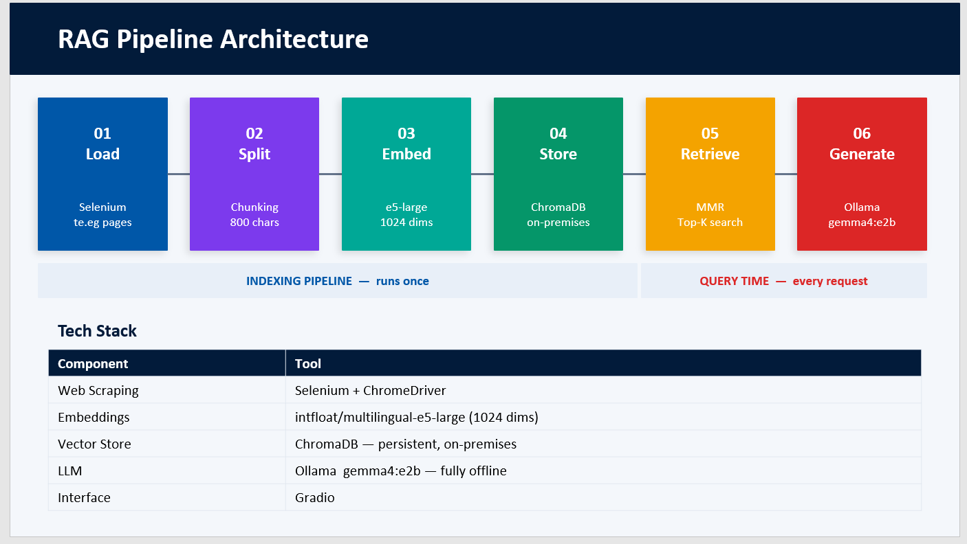

Slide 7
Data Sources
1. Primary Source:
- Telecom Egypt Website (https://te.eg)
2. Additional Sources:
- PDF - DOCX - TXT - HTML - Images (OCR)

Slide 8
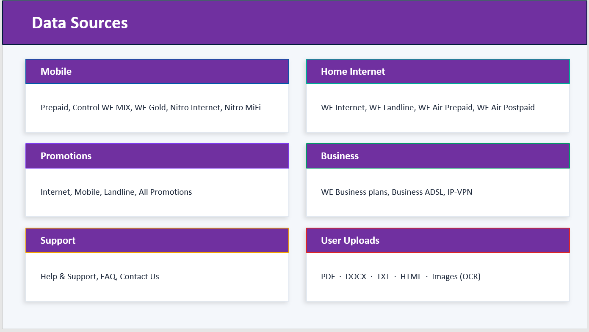

Slide 9
Key Features of System
Multilingual support (Arabic & English)
Egyptian dialect understanding
Document upload & querying
Source citation in answers
Chat interface

Slide 10
Handling Egyptian Dialect
Initial Approach:
Used Nile-Chat model
Strong performance in Egyptian dialect
Weak performance with English queries
Final Approach:
Switched to Gemma (gemma4:e2b)
Balanced performance for Arabic & English
Enhancements:
Multilingual embeddings
Prompt engineering for dialect normalization
Result:
Improved understanding of mixed-language queries
More consistent and accurate responses

Slide 11
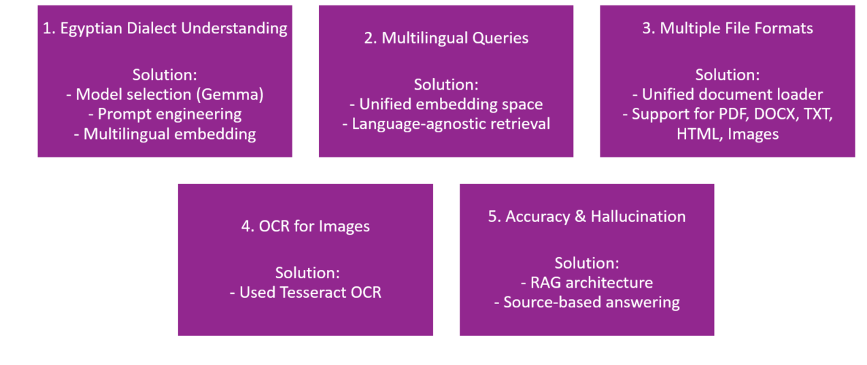
Challenges & Solutions

Slide 12
Thank You

